Slide 1
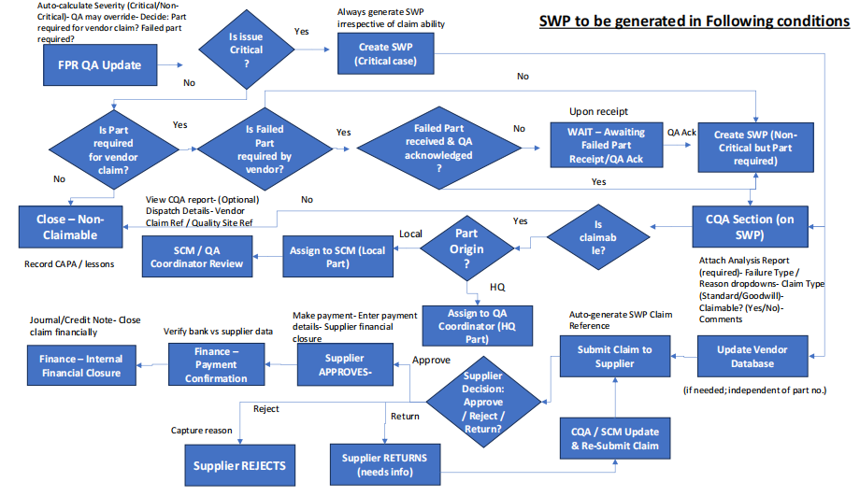

Slide 2
Thank You
Selfservit Solutions (P) Ltd.
(CIN – U72900TN2008PTC068979)
www.selfservit.com www.mservice.in
Chennai: HO
No. 51/2 (Old No. 26)
1st Main Road West, Shenoy Nagar West Chennai – 600 030
Ph- +91-76048-78864
Hyderabad
Bangalore
3262/1, 1st Floor, 13th Cross 2nd Stage, Indira Nagar, Bangalore – 38
Ph - +91-80-25216635
Plot No. 6, Lane. Opp OBC Bank, 1st Floor, Bethany House Secunderabad – 500003
Ph- 99891-21094

